Slide 1

E-COMMERCE APPLICATION FOR AGRICULTURAL PRODUCTS
Under the Guidance of
Prof. Gaurav Deshmukh
Computer Engineering BE B Group: PHI-CS-45
Akanksha Narendra Mishra | TU3F1617088
Anurag Maroti Shete | TU3F1718137
Neha Milind Shirodkar | TU3F1718119
Raj Gajendra Patil | TU3F1718112

Slide 2
TABLE OF CONTENTS
1. ABSTRACT
2. INTRODUCTION
Aim and Objectives
Scope
3. LITERATURE SURVEY
4. APPLICATION ANALYSIS
Proposed systems
Features
Hardware and software requirements
5. DESIGN AND IMPLEMENTATION
6. CONCLUSION
7. REFERENCES

Slide 3
ABSTRACT
Electronic commerce (EC) is a term for any type of business, or commercial transaction that involves the transfer of information across an electronic network, primarily the Internet.
EC has expanded rapidly over the past decade and is predicted to continue at this rate, or even accelerate as it allows consumers to exchange goods and services with no barriers of time or distance and it is often faster, cheaper and more convenient than the traditional methods of commerce
With the improvements in the internet, online shopping has been more popular among users. Consumers can shop from online stores that allow them to shop without physically going into shops.
The internet has been an essential business platform for the product trade of products between organizations and consumers and even between consumers themselves.

Slide 4
INTRODUCTION
EC can be basically defined as the production, promotion, selling and distribution of products and services in an online environment.
Agricultural Ecommerce is a method for reducing administrative cost and cycle time, re-organizing farm processes and improving relationships between both business partners and customers
Considering the characteristics of its business operations, EC category used for the project is B2C- Business to Consumer.
Business-to consumer (B2C): B2C EC is defined as the selling of the businesses into the general public which is the most attractive trade through the internet.
Online insurance and banking can be counted under this category.

Slide 5
Aim and Objectives
The Ecommerce App is a portal which allows merchants in developing countries to advertise and sell their goods.
This would permit rural communities to make their wares available to the rest of the world.
The objective is to create a platform which would allow product information to be updated securely using a mobile device and will allow users to buy goods form the merchant.
The main concern is given to the village people to explore their agro-products and to enhance our traditional Indian culture.
In future the internet will become the whole and soul to the business fields.
The E-Shetkari portal will help the rural people as a business entity.

Slide 6
Scope
An Application of Ecommerce which will consist of various different ingredients:
Features:
A user will be able to see and surf through all the products available by using facility of “filter” and “sort by”.
User will be able to surf or see only those data which will be uploaded in the database.
System Features:
Trouble-free registration process.
Indelible user experience.
Relevant and Authoritative App Content.

Slide 7
LITERATURE SURVEY
Although there is increase in production of agricultural products, the farmers are not benefiting.
Empowering farmers through ICT can prove really beneficial in aspects such as:
• Exchange in information will reach larger masses in spite of larger limitations literacy level and local languages.
• Promoting agricultural products to larger masses
• Improved farming techniques and best practices; that enhance the yield and reduce cost of inefficiency.
AGMARKET was the first e-governance project, which was set up in the year 2000 to strengthen India’s agricultural marketing system.
It has emerged to be a key national portal.

Slide 8
APPLICATION ANALYSIS
Proposed System:
The target of the proposed system is as follows:
Reduce the cost
Create, process, distribute, retrieve and manage the paper-based information by digitizing the information.
Better customer services by simplifying the business processes and make them faster and efficient.
More options to compare and select the cheaper and better options.
Enable rural areas to access services and products, which are otherwise not available to them.

Slide 9
Features:
Admin Features:
Manage products
Add or remove products
Add Product details like name and their cost
Edit Product Details
Keep track of Sales History
View and Manage Customers
User Features:
User Signup
Add contact and address details
View products
Add desired products to the cart
Add multiple products to the cart
Purchase desired products by online payment
Receive an e-mail about transaction confirmation

Slide 10
Hardware & Software Requirements:
Hardware Requirements:
1 GB RAM
Intel 1.66 GHz Processor Pentium 4
200 GB HDD
Any Android Mobile Phone
Software Requirements:
Integrated Development Environment:
Microsoft Visual Studio
Android Studio
Database:
Microsoft SQL Server
Operating System:
Windows
Android
Web Browser: Google Chrome
Technology Stack:
Asp.Net
HTML
CSS
C#
Android Studio: Java

Slide 11
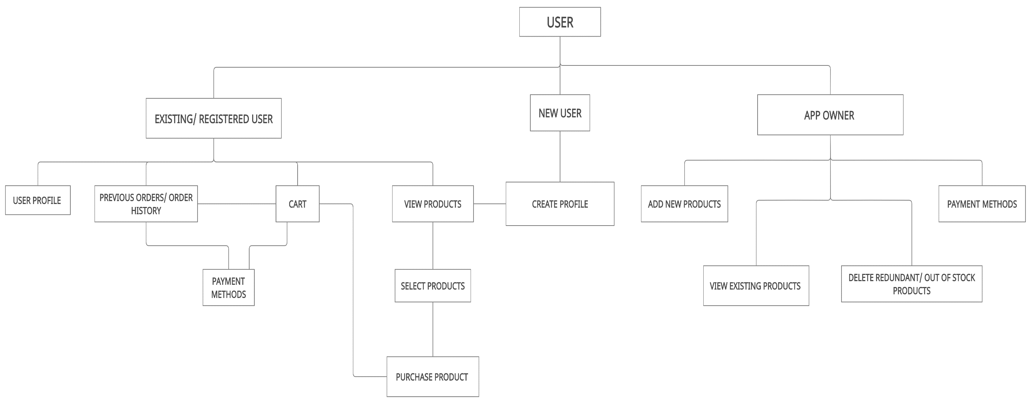
Information Architecture Diagram

Slide 12
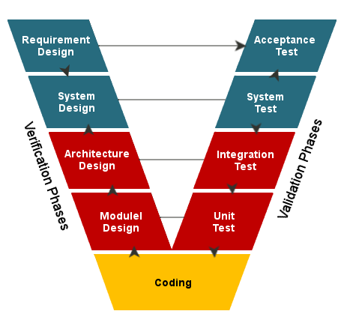
V MODEL for the Application

Slide 13
DESIGN AND IMPLENEMTATION
AGRICULTURE Ecommerce APPLICATION DESIGN:
The system is categorized into two sections namely Admin and User.
Admin is web-based, whereas the user gets access to the mobile application.
The Admin will access the website through a web browser like Google Chrome, Firefox etc.
On the web framework, the database is connected through Microsoft SQL Server.

Slide 14
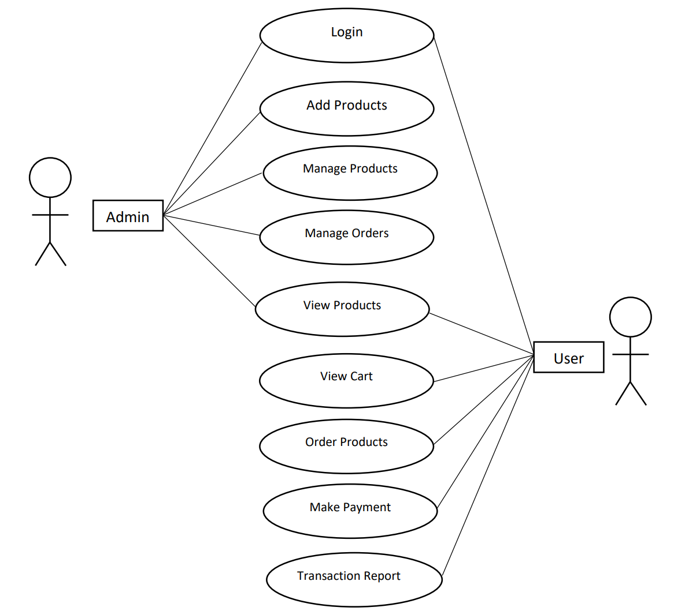
Use Case Diagram

Slide 15
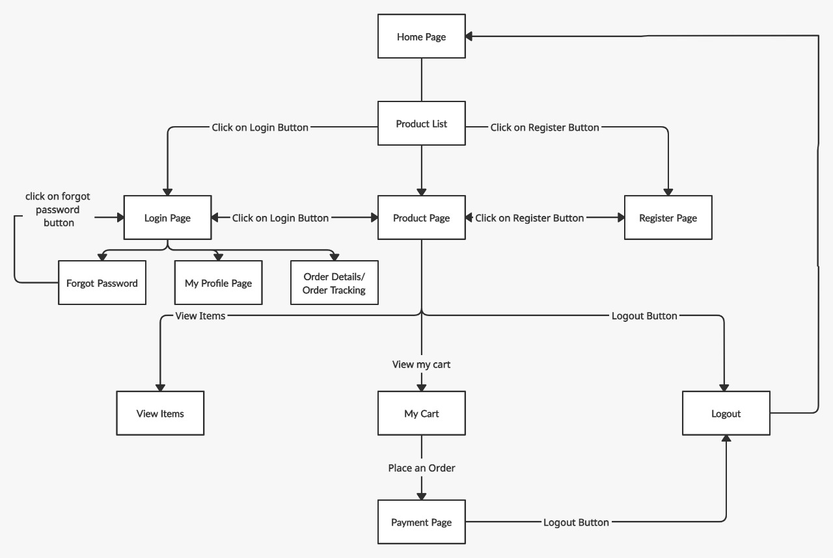
User Flow Diagram

Slide 16
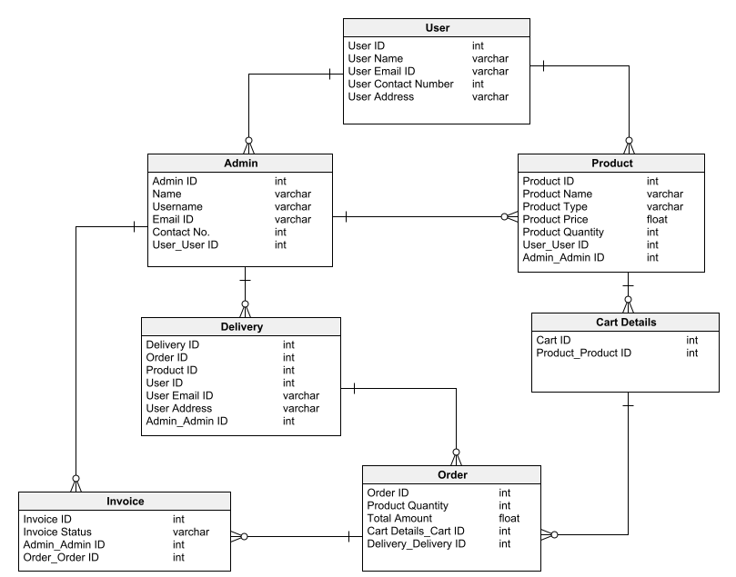
Data Model

Slide 17
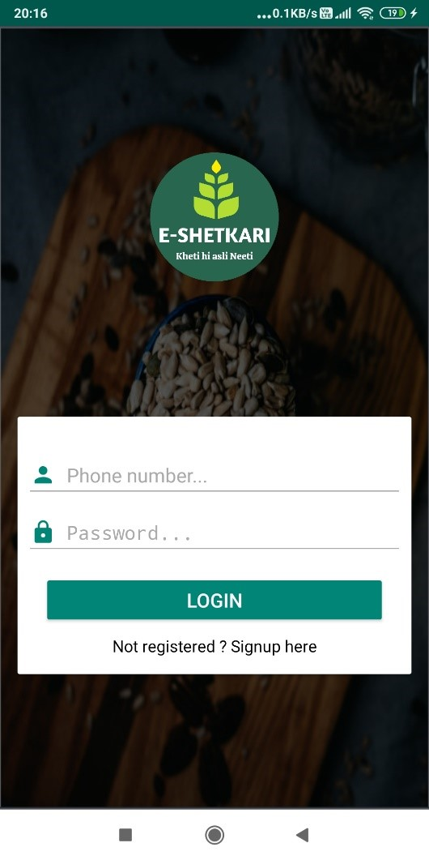
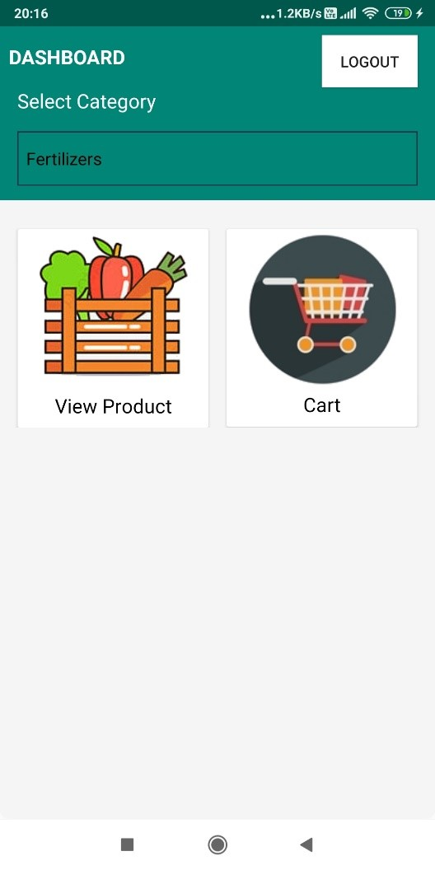
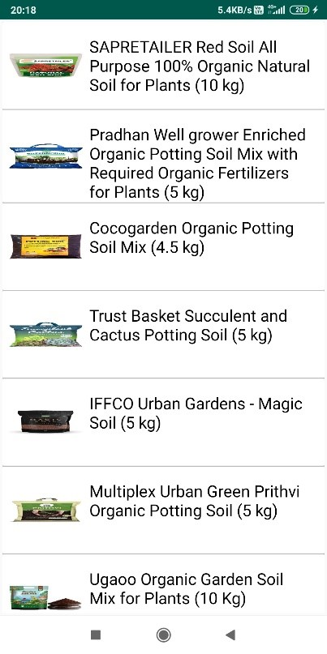
Implementation of the Mobile Application
Login Screen Dashboard Product List

Slide 18
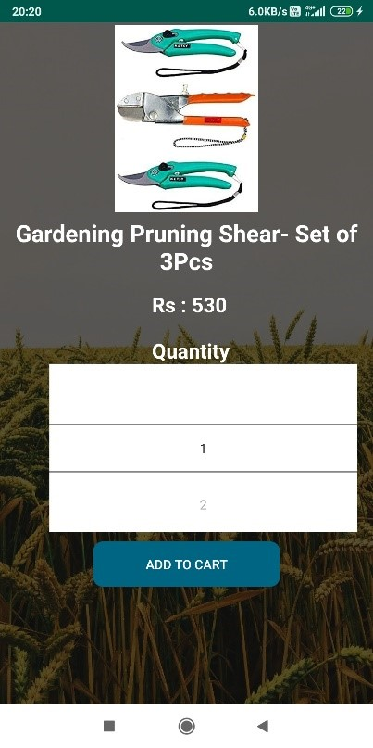
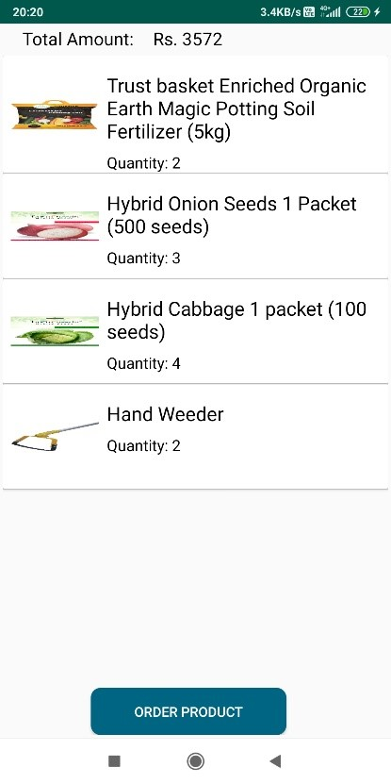
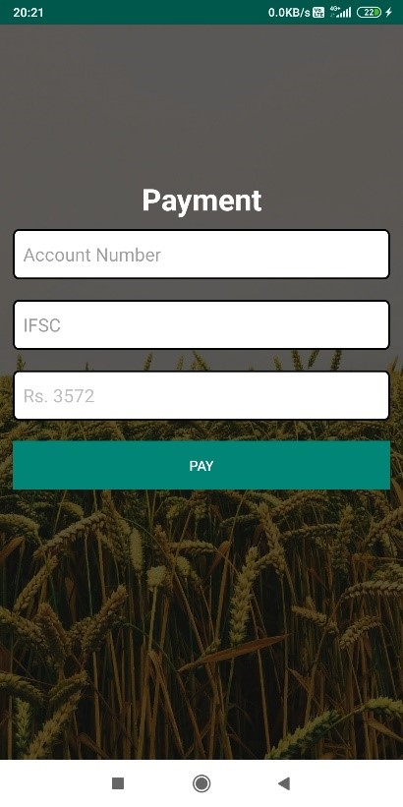
Individual Product Screen Cart Screen Payment
Screen

Slide 19
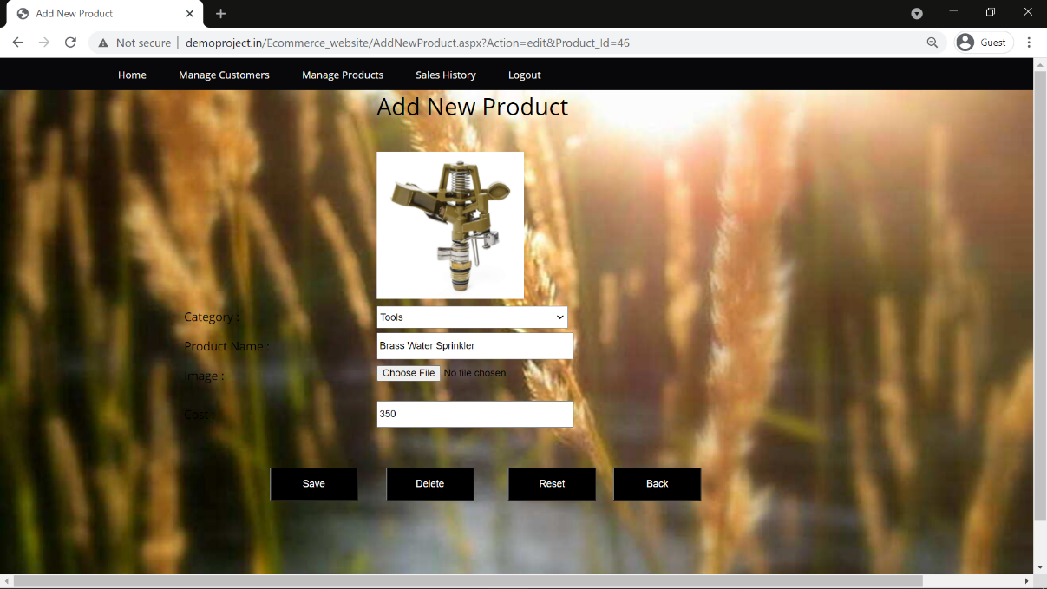
Admin Add New Product Page

Slide 20
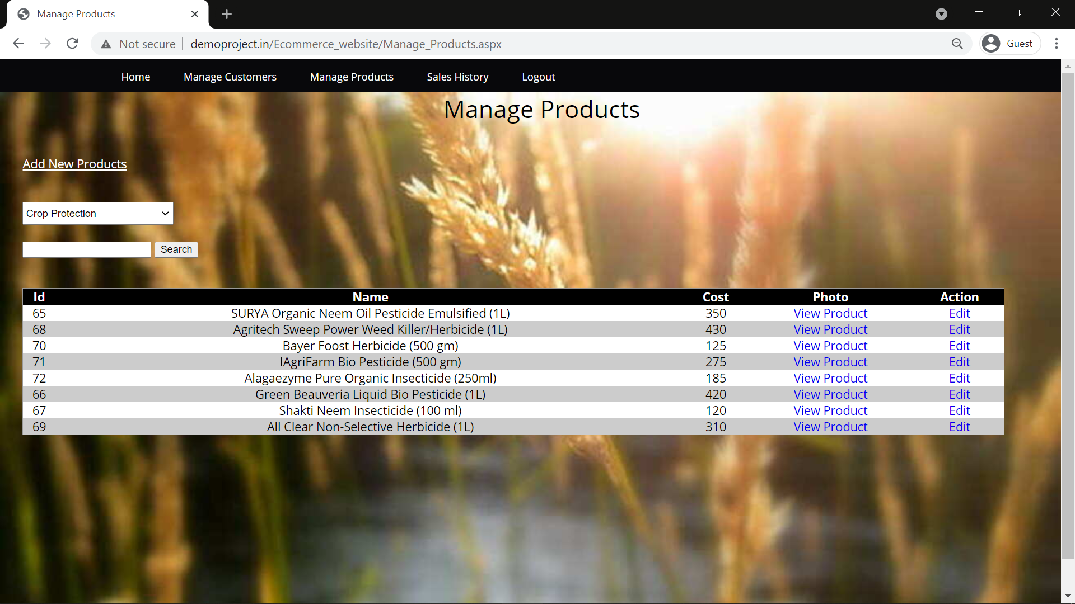
Admin Manage Products Page

Slide 21
BENEFITS OF IMPLEMENTING AGRICULTURAL ECOMMERCE:
Reducing administrative cost and cycle time.
Re-organizing farm processes and improving relationships between both business partners and customers.
Allows small farms to have access to the same markets as larger farms.
Extend business by increasing opportunities with customers, suppliers and other farms.
Attract additional customers because of a higher level of customer service.
Lead to better customer relations and increase the number of customers.

Slide 22
CONCLUSION
Changes the way farms and individuals purchase agricultural products by delegating tasks involved in buying and selling to intelligent mobile agents.
Connect buyers and sellers in a way that ensures the integrity and visibility of valuable products to consumers, while trading partners can share a wide range of communiqué and data.
When implemented, the integrity, effectiveness and efficiency of trading in the agricultural industry is ensured.
It stands a better chance of generating higher revenue for the government than E-commerce.

Slide 23
REFERENCES
1. Ali Research Institute.Ali agricultural e-commerce development white paper. 12(4), 2-4, 2015.
2. Zhao Ping, Luo Yi. Case Study and Enlightenment on the development of agricultural products e-commerce-taking
Food Steward" and Freshdirect as examples. Business Economics And Management, 19-23, 2011(07).
3. Luo Yi.Some Thoughts on the Development of e-commerce of Agricultural Products in China-Study on multiple cases, 110-116, 2012(09). , 020 (2017) DOI: 10.1051/ 710002040 2016 MATEC Web of Conferences 100 GCMM 40 matecconf/201 5.
4. Cui Jing.Tootoo industrial commune:the control of whole supply chain. China 's Economy and Informa-tization, 56- 57, 2013(14).
5. Zhi Ying.Those things about originally life network and chu orange-Interview with assistant to the President of Originally life network. China Advertising, 85-87, 2014(08).
6. Wu Wenmi. The way of Suichang mode of letting the agricultural products business platform landing. Innovation technology, 48-49, 2014(07).
7. Ali Research Institute.research on Suichang model. (30)10, 2013.

Slide 24
Thank You

